Slide 1

Introduction and Types

Slide 2
INTRODUCTION
Intellectual property law protects the results of human creative endeavour i.e. writers, inventors, artists transform ideas into tangible property.
When this intellectual property qualifies under law and the creators granted certain rights

Slide 3
Classification of property
    Movable property: In civil law systems, personal property is often called movable property or movables – any property that can be moved from one location to another.
    Immovable property: Immovable property is an immovable object, an item of property that cannot be moved without destroying or altering it - property that is fixed to the earth, such as land or a house.
    Intellectual property: Intellectual property (IP) refers to creations of the mind, such as inventions; literary and artistic works; designs; and symbols, names and images used in commerce.

Slide 4
Meaning
Ideas and creations of mind, having commercial value are called IP (Intellectual Property). Legal rights associated with Intellectual Property are called “Intellectual Property Rights.”
Basic purpose of Intellectual Property Rights is to recognize and reward , effort and also to protect such effort from wrongful use by making it a “legal offence”.

Slide 5
Definition
According to WIPO (World Intellectual Property Organization)- Intellectual property (IP) refers to creations of the mind, such as inventions; literary and artistic works; designs; and symbols, names and images used in commerce.
Intellectual Property Rights refers to “the general term for the assignment of property rights through patents, copyrights and trademarks. These property rights allow the holder to exercise a monopoly on the use of the item for a specified period”.

Slide 6
Features of Intellectual Property
Documentation : (Need Documentation)
Legal Authorization: (Need legal Acceptance)
Description: (details of Intellectual property, whether it is a trade mark or patent, or copy right )
Ownership : (identify the original owner for registration)
Time Duration: Intellectual properties have time duration based on the property
Fee: the owners has to pay prescribed fee for protecting their intellectual property
Commercial value: intellectual properties have commercial value it means we can sell and we can buy

Slide 7
Importance of intellectual property
Enhancing profitability
It is a business strategy
It is crucial to success in the market place
More useful to the manufacturing sector
Useful for compete with competitors
Useful to the customers
Economy development

Slide 8
INTELLECTUAL PROPERTY LAW BASICS
Legal system provides certain rights and protections for owners of property.
Rights and protections for owners of intellectual property are based on patent, trademark and copyright laws and state trade secret laws.
In general, patents protect inventions of tangible things; copyrights protect various forms of written and artistic expression; and trademarks protect a name or symbol that identifies the source of goods or services

Slide 9
Objectives of Intellectual property Law
Absolute protection
Financial incentive
Economic growth
Increase monetary value
Morality

Slide 10
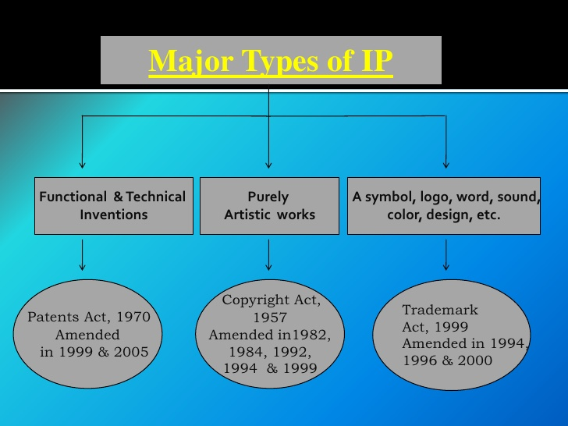

Slide 11






ORGANIZATION STRUCTURE
Ministry of Commerce & Industry
Dept. Of Industrial Policy & Promotion
Controller General of Patents, Designs & Trade Marks
Patent & Design Office
Trade Marks Registry
Geographical Indications Registry
Patent Information System
Kolkata
Mumbai
Chennai
Kolkata
RGNIIPM
Delhi
Delhi
Mumbai
Chennai
NAGPUR
Chennai
Ahmadabad
Rajiv Gandhi National Institute of Intellectual Property Management (RGNIIPM)

Slide 12
TYPES OF INTELLECTUAL PROPERTIES
Patents ( for inventions)
Copy rights ( for creative/ Artistic works/ Software works)
Trade mark ( for marks used in business)
Industrial design ( for external shape of the product)
Layout design of integrated circuits
Geographical indicators ( for goods from a particular region Ex: Darjeeling- Tea)
Plant varieties ( for new varieties of plant)
Trade secrets ( for information of commercial importance)

Slide 13






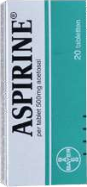

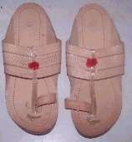
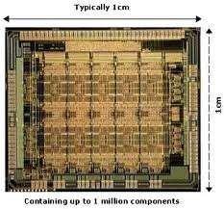
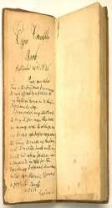

Types of IPRs
Intellectual Property
Industrial Property
Copyrights and related rights
Industrial | Patents Trademarks Trade Secrets | Geographical | Layout Designs of | Plant varieties &
Designs | Service marks | Indications | Semi Conductor ICs | Farmer’s rights
®
©
™

Slide 14
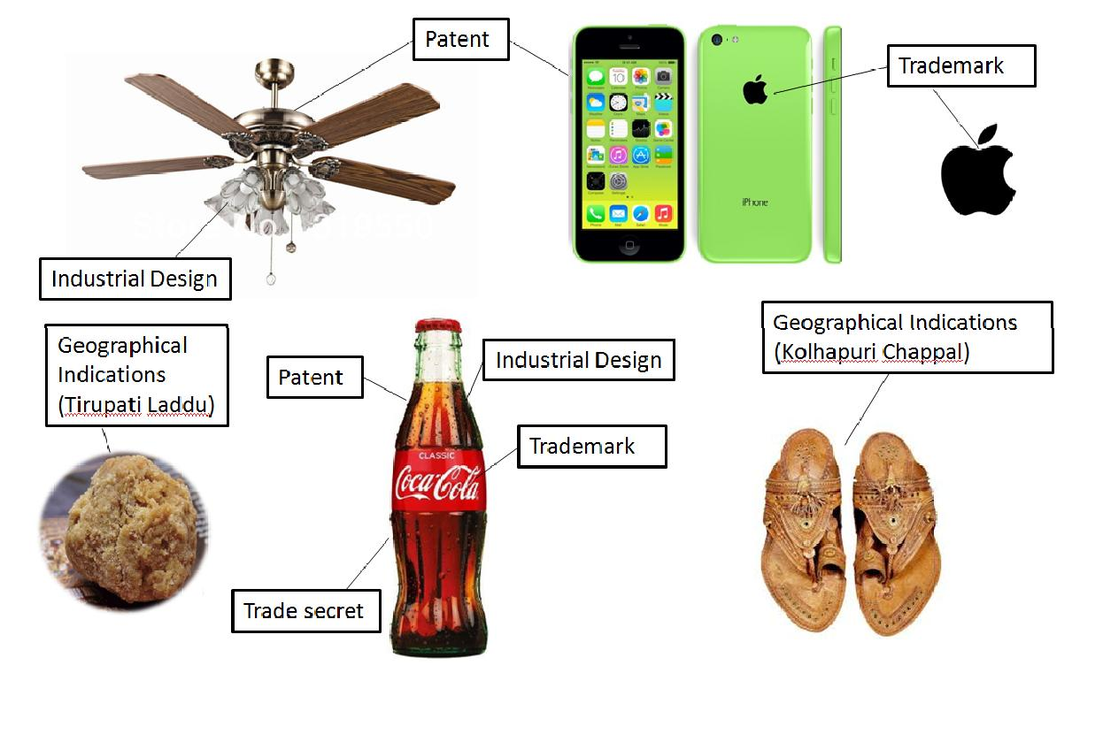
INTRODUCTION TO IPR

Slide 15
The main types of intellectual property rights
Copy rights
Patents
Trademark
Trade secrets

Slide 16
Copy rights
“Copyrights are a set of exclusive rights granted by law to the creators and producers of forms of creative expressions such as literary, musical and cinematographic works” An original work which is protected by copyright bears the symbol.
The best forms of copyrights are authored and edited books, audio, video cassettes which cannot be reproduced without the permission of the person who holds the copyright.
In India, in 1957 the first copyright act formulated and introduced. This was amended in 1983, 1984, 1992, 1994 and 1999. It was accepted by parliament in 30th December, 1999 and came into force from 15th Jan, 2000.

Slide 17
Exclusive rights of Copyright owner
  Reproduce work
  Prepare derivative works
  Distribute work to the public
  Perform work in public
  Display work in public

Slide 18
Copyright
Term: generally, 70 years after death of author corporate authorship, 95 years from
Publication years from creation, whichever expires first.
Benefits of copy right registration
Registration required before a copyright owner bring suit for infringement
Registration may serve as evidence the copyright in the work is valid
Registration may give actual or constructive no copyright claim

Slide 19
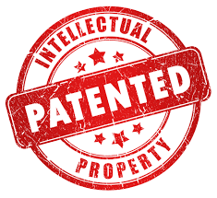
Patents
A patent is an exclusive right granted by the government to the original inventor/researcher/developer of an invention, which prohibits others from making, using or selling that invention. These are granted for a specific period only. The grant of patent or exclusive rights over inventions encourages people to think creatively and come up with new inventions and innovations which benefit society.
In India, in 1970 the first patent act was introduced. This was amended in 20th December, 1999 which was approved by Rajyasabha. It was again amended in 2002 and 2005. The patent (amendment) act was come into force in 1st Jan, 2005.
When Thomas Edison ran electricity through an incandescent filament in 1879, he invented the modern light bulb, and what he got for it was a patent. Patents protect inventions.

Slide 20

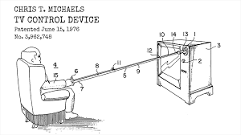
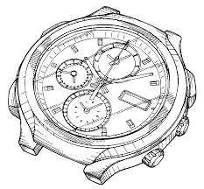
Types of patents
Design Patent: Design patents cover the ornamental features (i.e., appearance) of a product.
Utility Patent: Utility patents are the most common, and they cover processes, machines, articles of manufacture, and compositions of matter.
Plant Patent: Plant patents cover newly developed varieties of plants provided they can be reproduced asexually.

Slide 21
Requirements for patentability
Novelty: Must be “new” (i.e., not already know the general public or those skilled in The field of invention).
Utility: Must have a useful purpose and actual work. Must not be frivolous or immoral
Non-Obviousness : Must not be obvious to a p with ordinary skill in the field of the
invention at time the invention was made
Term: typically 20 years, but actual term varies depending upon country issuing patent.

Slide 22
Elements of patent rights
• Exclusive rights over inventions.
• Motivator for innovative Engineers.
• We can get details at www.ipindia.nic.in -- patents.
• As long as maintenance fees paid (upto 20 years), these can be protected.
• Patents granted by controller of patents, having head office located at
Calcutta and branches at New Delhi, Chennai and Mumbai.
• Covered under Ministry of Commerce and Industry.

Slide 23
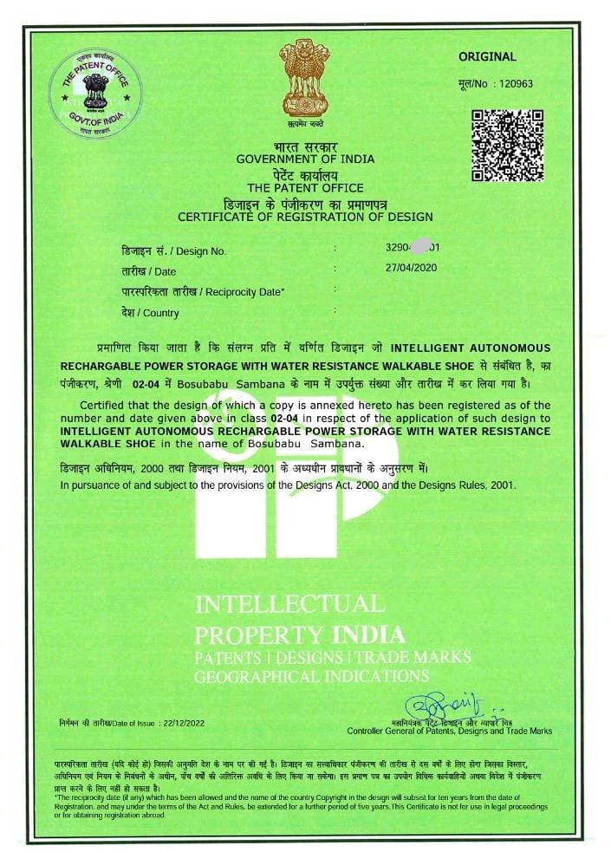

Slide 24
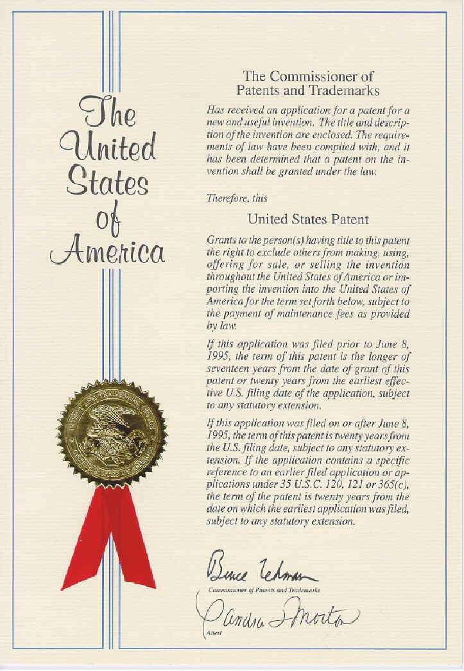
Certificate of PATENT

Slide 25
TRADE MARKS
“A trade mark or service mark is a word, symbol, name, design or device used to indicate the source quality and ownership of a product or a service. Trademarks provide guarantee of quality and consistency of Product or service they identify”.
Two types of symbols associated with trademarks: (i) TM indicates that trade work, (ii) SM indicates that service work has been filed for particular mark, but trademark is not yet granted. It indicates that the trademark is registered.
In India, The Trademark Act was introduced in 1999; it was the replacement of Trade and Merchandise Act 1958. It was amended in 2002.

Slide 26




Trade Marks
Name
Logotype Symbol Slogan
Shape Color

Slide 27
Trade Mark
When George Eastman came up with the name KODAK® for his camera in 1883, what he cam with was a trademark. Trademarks include brand names, logos, slogans and even product shape colors and sounds.
Choosing a Trade Mark
The strength of a trademark varies according to
Generic: name of product or service Ex: Furniture, Computer
Descriptive: tells something about product or service directly
Ex: Airtel , American Airlines
Suggestive: suggest something about product or service indirectly
Ex: Jaguar: Suggests cars that are very fast., Microsoft: Suggests software for small computers.
Netflix: The subscription service suggests movies ('flicks') that are ordered online.
Arbitrary: no relationship to product or service
Ex: Amazon (online marketplace). ,Apple (technology company), Camel (tobacco products).,
Dove(personal care products). Shell (gas stations), Virgin (wireless communications).

Slide 28

TRADEMARKS

Slide 29
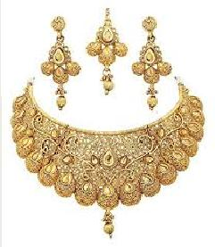
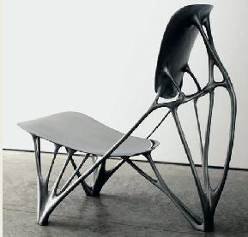
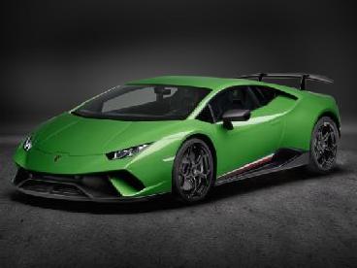
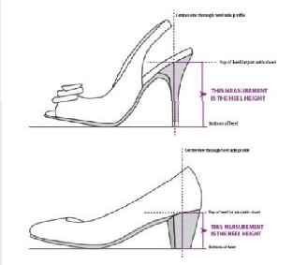
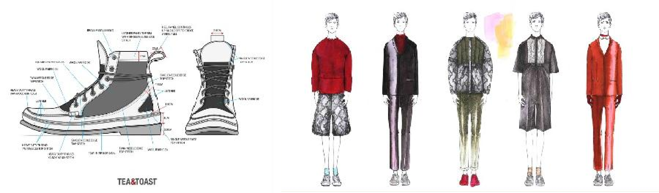

INDUSTRIAL DESIGN
Exclusive right against unauthorized copying
Protection normally lasts for an initial ten years, after which it can usually be renewed for, in most cases, up to 15 years.
a ts
➢ Promote
s more innovat
ive and aesthetically
ttractive produc

Slide 30
INDUSTRIAL DESIGNS:
Design is important and has commercial value in case of certain goods where shape matters and influences purchase.
ex: shape of mobile phones, design of shoes, features of ball pens etc. These refer to specific shape, configuration, surface, pattern or colour combination which produces an aesthetic impression of the article.
To make Indian Laws compliant with international obligations in this respect, a new Act, ‘The Industrial Design Act, 2000 was enacted by Parliament replacing Designs Act, 1911. The Act came into force w.e.f.11-5-2001.

Slide 31
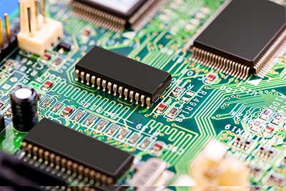
LAYOUT DESIGN OF INTEGRATED CIRCUITS
IC is a product having transistors and other circuitry elements, which are inseparably formed on a semiconductor material or an insulating material or inside the semiconductor material designed to perform an electric circuitry function. (In 1984 USA implemented SCPA – Semiconductor chip protection Act)

Slide 32
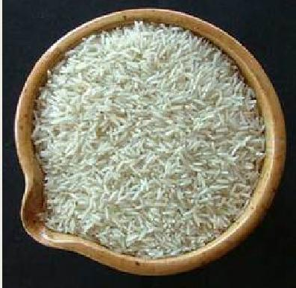


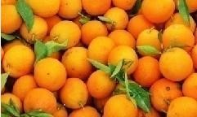

GEOGRAPHICAL INDICATIONS
Examples of Indian Geographical Indications:
Basmati Rice
Darjeeling Tea
Kanchipuram Silk Saree
Alphonso Mango
Nagpur Orange
Kolhapuri Chappal
Bikaneri Bhujia
Agra Petha

Slide 33
GEOGRAPHICAL INDICATORS
Geographical Indicator means the goods or products which are originating from a particular geographical region situated in a particular country. Ex: Assam tea, Kanchi Sarees, Nirmal paintings etc.
India as a member of WTO, enacted geographical indications of goods (registration of protection) Act, 1999 which came into force on 15th Sept, 2003. These are also covered under article 22 to 24 of TRIPS Agreement.

Slide 34
PLANT BREEDER RIGHTS
“These are legal rights granted by the Government for protection of plant varieties, rights of farmers and plant breeders”.
The main theme of this aspect is ‘ Inventors do not loose the benefit of honest effort in identifying medical value of plant extract, since the evaluation use and maintenance of plants is encouraged by patent system.

Slide 35

PLANT PATENT

Slide 36
TRADE SECRETS
Maintaining a trade secret is an indication of the fair business practice. These are very valuable and proprietors practice all the necessary means to protect them. Trade secrets required security.
The creation of a company security plan may be a task in which the paralegal is involved. It requires execution of special confidentiality or nondisclosure agreements between employees, independent consultants or other companies. These refer to proprietary information having commercial application and value”.
In India though no exclusive legislation exists, but the matter would be covered under Indian Contract Act 1872.

Slide 37


Slide 38
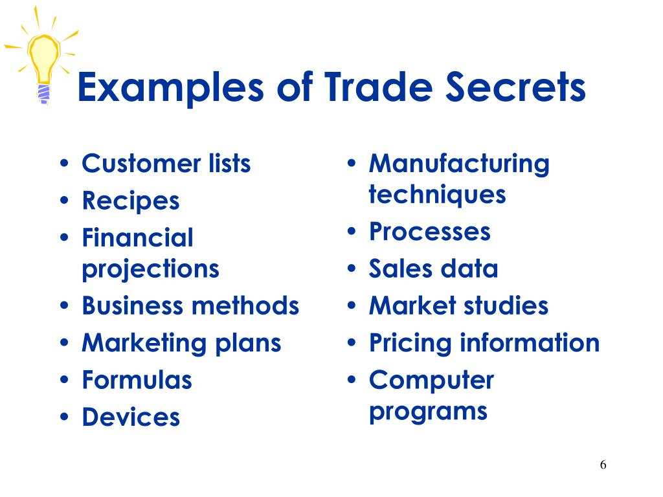

Slide 39
Trade Secrets
When Dr. John S. Pemberton mixed together sugar syrup and other ingredients in 1886 to make a refreshing new beverage, he came up with the secret formula for COCA-COLA®. He kept it secret and protected it as a trade secret.
A trade secret is information that: (1) provides a business with a competitive advantage; and (2) is treated in a way that can reasonably be expected to prevent the public or competitors from learning about it, absent improper acquisition or theft.
Trade secrets examples: A formula for a soft drinks, Marketing strategies, Manufacturing techniques, Computer algorithms, Customer lists.

Slide 40
THANK YOU

